Slide 1
Polynomial Regression

Slide 2
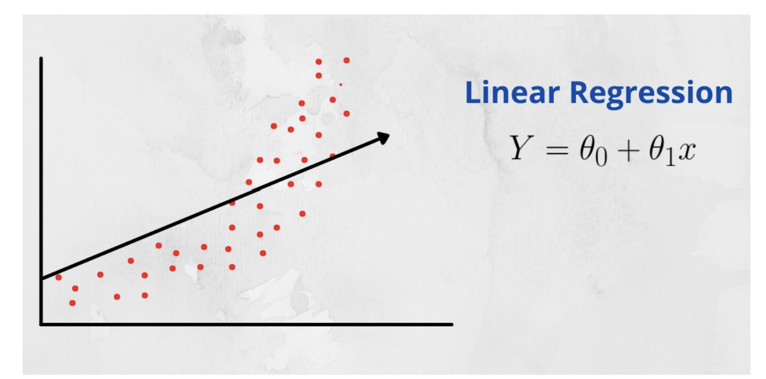
Why?
In simple linear regression algorithm only works when the relationship between the data is linear But suppose if we have non-linear data then Linear regression will not capable to draw a best-fit line and It fails in such conditions.
Linear regression does not perform well !
Hence, we introduce polynomial regression to overcome this problem, which helps identify the curvilinear relationship between independent and dependent variables.

Slide 3
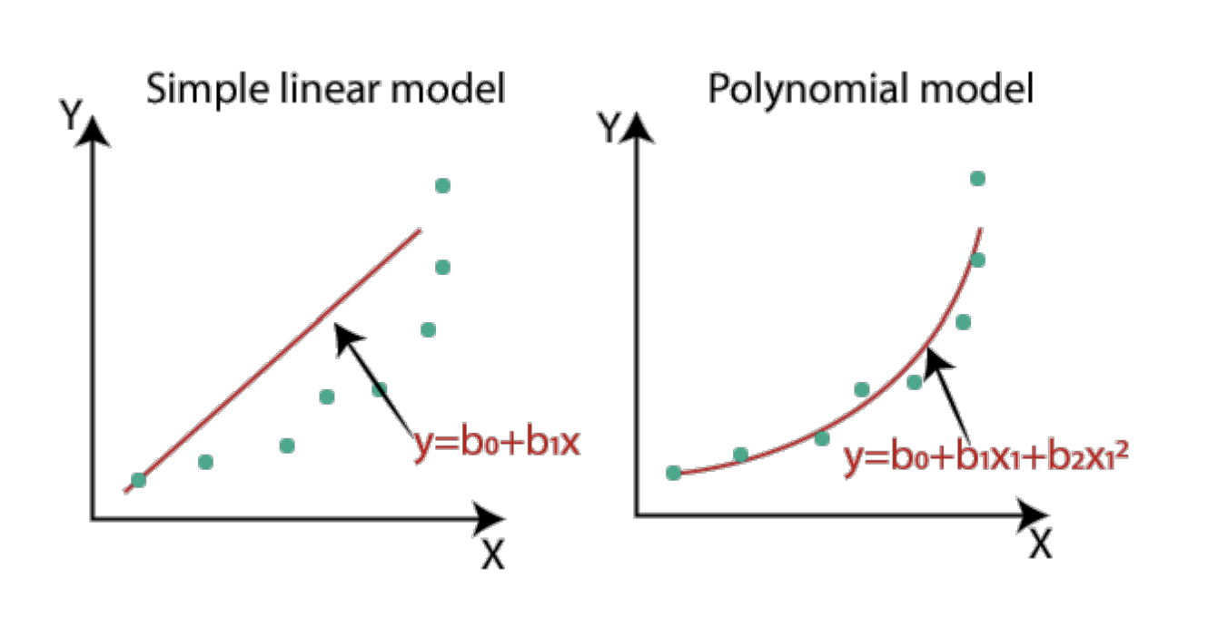

Slide 4
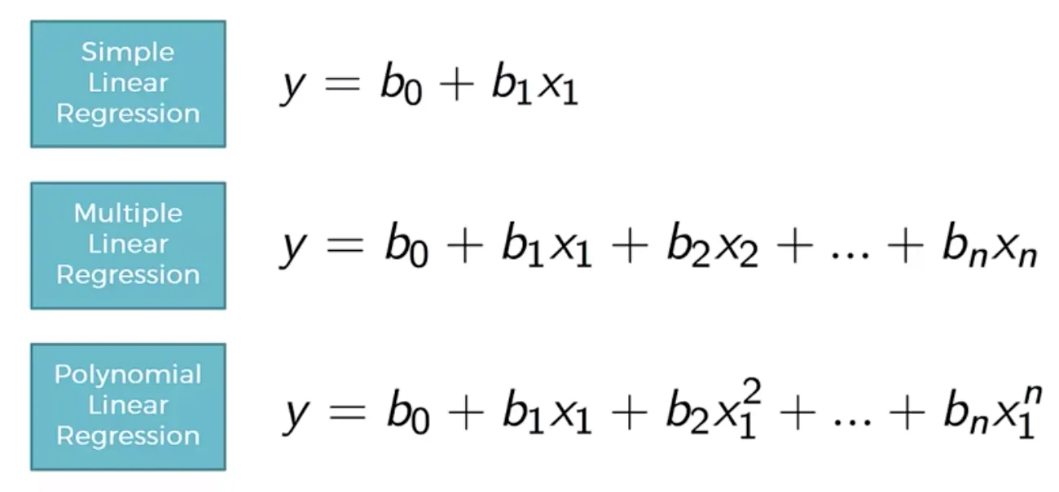
How Polynomial Regression is different

Slide 5
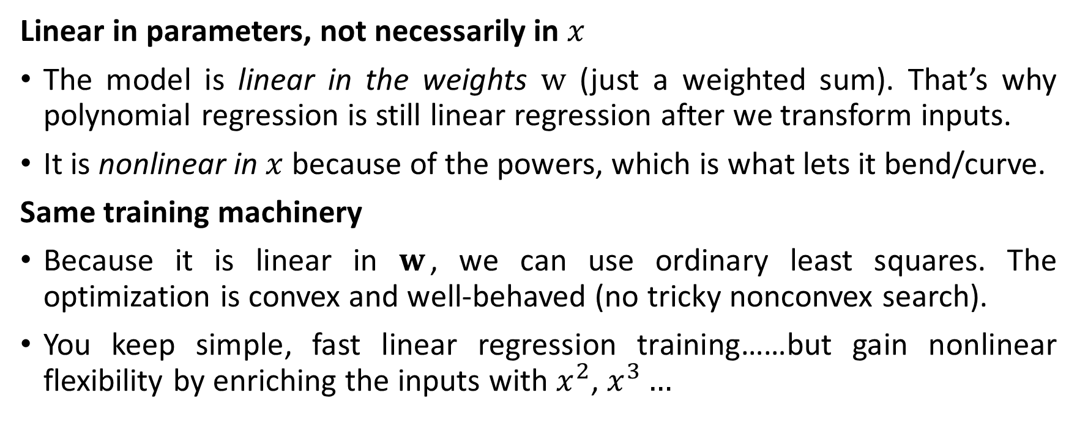
Linearity
Linear in parameters, not necessarily in $x$
The model is linear in the weights $w$ (just a weighted sum). That’s why polynomial regression is still linear regression after we transform inputs.
It is nonlinear in $x$because of the powers, which is what lets it bend/curve.
Same training machinery
Because it is linear in $w$, we can use ordinary least squares. The optimization is convex and well-behaved (no tricky nonconvex search).
You keep simple, fast linear regression training……but gain nonlinear flexibility by enriching the inputs with $x^{2}$, $x^{3}…$
Notes:
Take on example
Suppose $x=3$ and $d=4$. The feature vector is $\left[1 , 3 , 9 , 27 , 81\right]$. With weights $w=\left[2 , , − , 1 , 0.5 0 0.1\right]$,
$$\hat{y}=2+\left(−1\right)⋅3+0.5⋅9+0⋅27+0.1⋅81=2−3+4.5+0+8.1=11.6.$$

Slide 6
Bias Vs. Variance
Bias is the difference between the average prediction of our model and the expected value which we are trying to predict.
Variance is the variability in the model prediction, meaning how much the predictions will change if a different training data set is used.
Variance and bias form the two main sources of error in a model that we work to control, but there is also irreducible error, which is the error we can’t avoid or possibly eliminate.
Irreducible error is unavoidable error caused by elements outside of our control, such as noise from observations.

Slide 7
Bias Vs. Variance
In general, for ML models, simple models have high bias while overly complex models have low bias but high variance. We can identify our total error as this:
Error = Biased squared + Variance + Irreducible Error

Slide 8
Choosing Hyperparameters
When it comes to best fitting a model, choosing hyperparameters like the degree in a polynomial regression can have a major impact on the results of the model.
In almost all real-world data, there is some noise.
The goal for creating a model is to be able to make a prediction about the given training data while also generalizing well enough to predict the test data accurately.
Another factor to consider is the amount of data.
With a low volume of training data, being able to generalize well is difficult. Imagine trying to fit a potentially highly complex model to only 10 data points. This would make understanding the true relationship difficult.

Slide 9
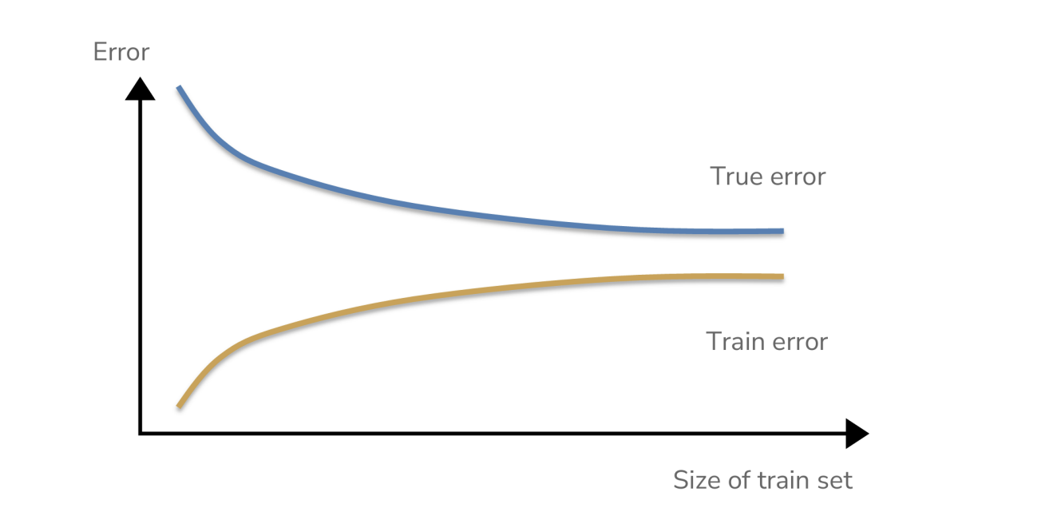
True and Train Error
With more data, our model will inherently begin to generalize better as outliers in the data have a decreasing impact on the overall model.
This is because increasing the number of data points to consider decreases the values placed on each data point individually
Because the model is generalizing better (reducing variance), train error slightly increases as it converges towards the decreasing true error.

Slide 10
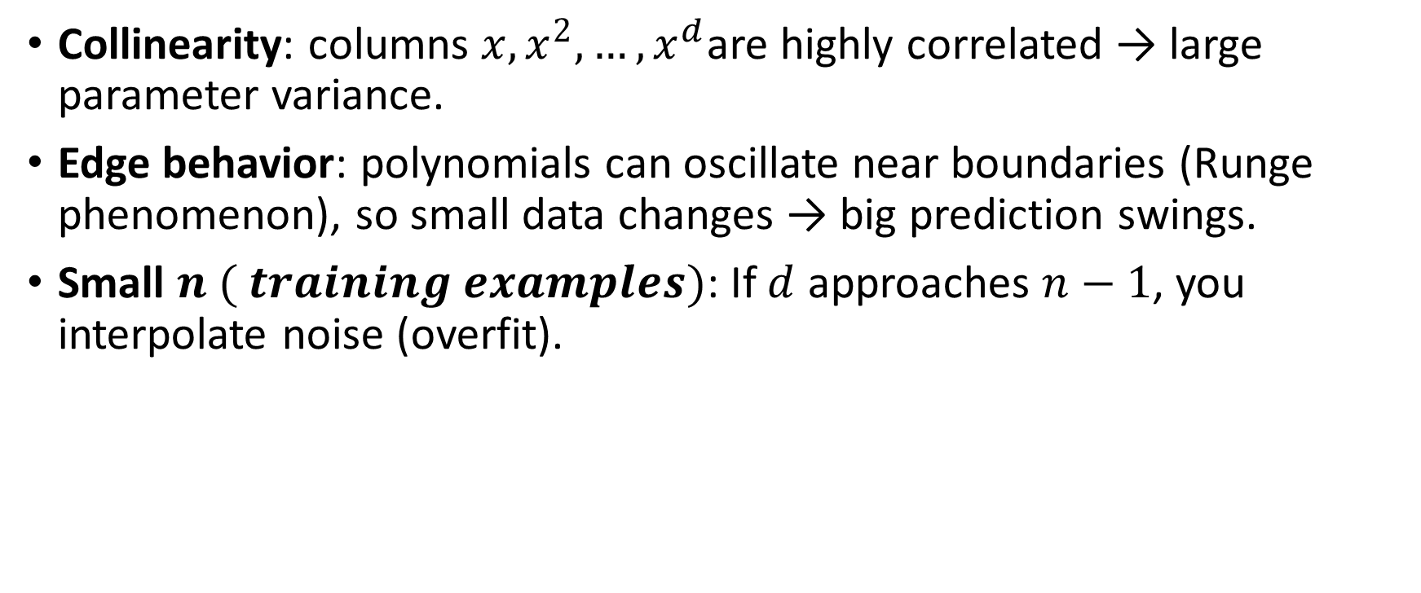
Why variance explodes with high degree
Collinearity: columns $x,x^{2},…,x^{d}$are highly correlated → large parameter variance.
Edge behavior: polynomials can oscillate near boundaries (Runge phenomenon), so small data changes → big prediction swings.
Small $n ( training examples)$: If $d$ approaches $n−1$, you interpolate noise (overfit).

Slide 11
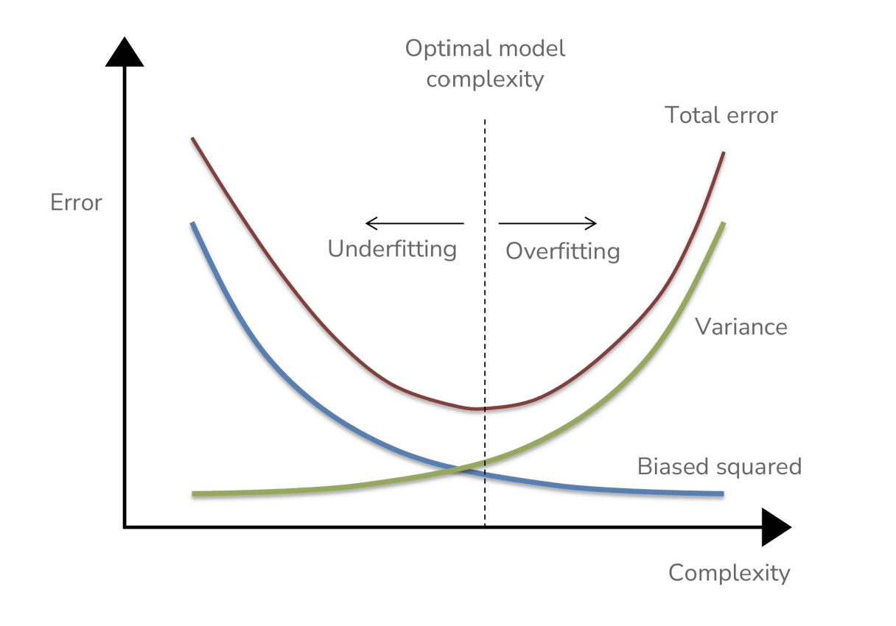

Slide 12
Summary
1. Choosing hyperparameters are essential for a well fitting model.
2. Overfitting and Underfitting
3. Simple models tend to have high bias and low variance and complex models ten to have low bias and high variance.
4. Choosing a model which has 0 training error is often not a good idea due to its high variance.
5. Error as a function of train set size

Slide 13
Takeaways
By choosing a model based on test error we will minimize variance as we compare different model complexities
However, this situation would create a biased approach.
Our goal for a test set is to have a pure, ”untouched” representation for our model
If we chose the best model based solely on test data performance we are choosing a model for that set
The test set would no longer represent “the unknown” since we probed it many times to figure out which model would be best.

Slide 14
Takeaways
When choosing what type of model will perform the best, we must perform another split in our data.
Between a training and test set, there is usually an 80/20 split; however, this can vary depending on data set sizes.
To now choose a model’s hyperparameters without biasing towards the test set, we must create a third split of the data called a validation set.
This will allow us to make decisions about the model architecture and complexity without ever touching the final testing set.
We will learn more about validation sets in the next session.

